Slide 1

Information Retrieval Chapter 5: Performance Evaluation in Information Retrieval TY B.Sc. (CS)
Semester VI
Poornima .N
Assistant Professor, Department of IT/CS
1

Slide 2

1 Topics:
Precision
Recall
F-measure
Average Precision
Test Collections
Relevance Judgments
Experimental Design & Significance Testing
“Can we trust a search engine just because it gives us fast results — or do we need evidence?”

Slide 3
2 Why Do We Evaluate IR Systems?
Determine how well a search engine retrieves relevant documents
Compare different ranking algorithms
Ensure quality before deployment
Improve search accuracy over time

Slide 4
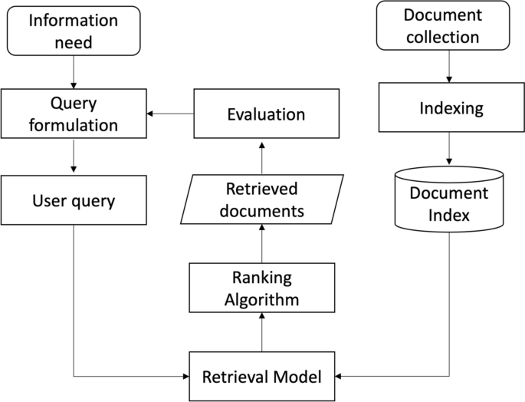

Slide 5
What We Measure?

Slide 6
Measuring Effectiveness of IR Systems
Precision
Recall
F-measure (balanced harmonic mean of precision and recall)
MAP (Mean Average Precision)
Precision at k, R-Precision
ROC Curve, NDCG

Slide 7
3 Precision
Precision measures the accuracy of positive predictions: out of all the items the model identified as positive, how many were actually correct?

Slide 8
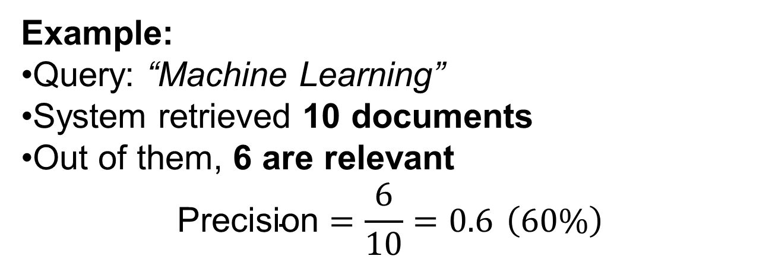
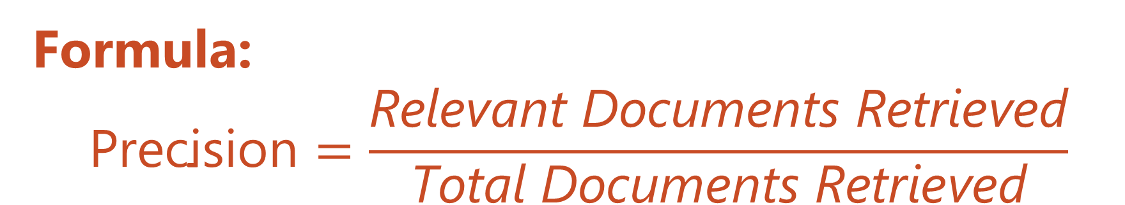
Formula: $$\text{Precision}=\frac{\text{Relevant} \text{Documents} \text{Retrieved}}{\text{Total} \text{Documents} \text{Retrieved}}$$
Example:
Query: “Machine Learning”
System retrieved 10 documents
Out of them, 6 are relevant
$$\text{Precision}=\frac{6}{10}=0.6 \left(60\%\right)$$

Slide 9
Document Title | Relevant?
Intro to Machine Learning | ✔
Cooking Recipe – Pasta | ✘
Deep Learning Models | ✔
Travel Blog | ✘
Machine Learning Applications | ✔
AI vs ML | ✔
Random News | ✘
Neural Networks Overview | ✔
Fashion Design | ✘
Robotics and ML Integration | ✔
Precision =
Relevant/Total Retrieved

Slide 10
3 Recall
Recall measures the model's ability to find all relevant instances: out of all the items that were actually positive in the data, how many did the model find?.

Slide 11
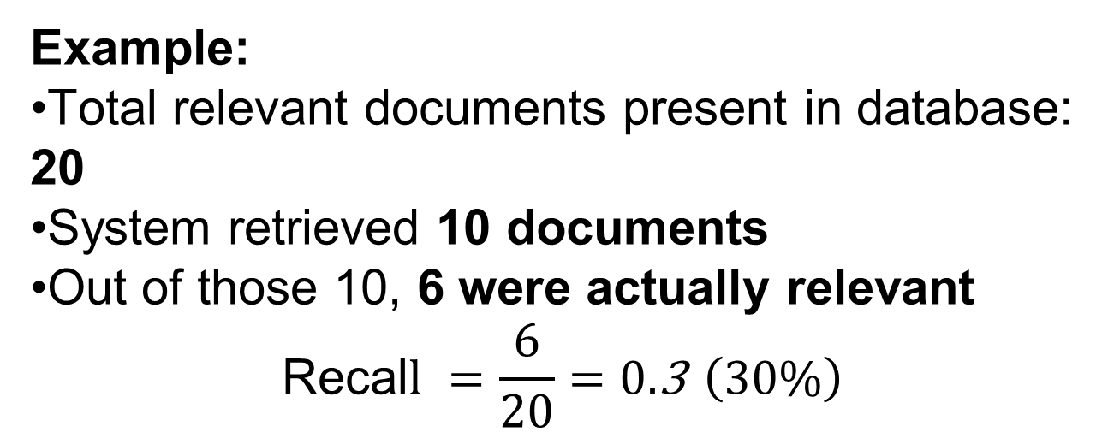

Formula $$\text{Recall}=\frac{\text{Relevant} \text{Documents} \text{Retrieved}}{\text{Total} \text{Relevant} \text{Documents} \text{in} \text{the} \text{Collection}}$$
Example:
Total relevant documents present in database: 20
System retrieved 10 documents
Out of those 10, 6 were actually relevant
$$\text{Recal}l =\frac{6}{20}=0.\text{3} \left(30\%\right)$$

Slide 12
3 Find All the Relevant Papers
Steps:
Total research papers available = 15
System retrieved 8 papers
Out of them, 5 were actually relevant
Calculate recall.

Slide 13
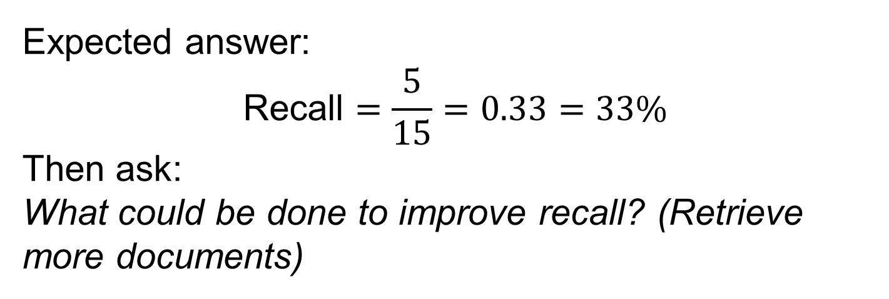
3 Find All the Relevant Papers(A)
Expected answer:
$$\text{Recall}=\frac{5}{15}=0.33=33\%$$
Then ask:
What could be done to improve recall? (Retrieve more documents)

Slide 14
 | Relevant | Nonrelevant
Retrieved | tp | fp
Not Retrieved | fn | tn

Slide 15
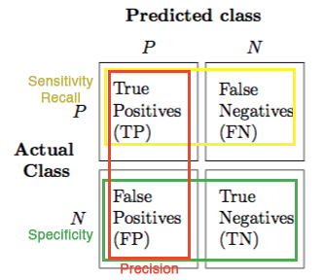

Slide 16
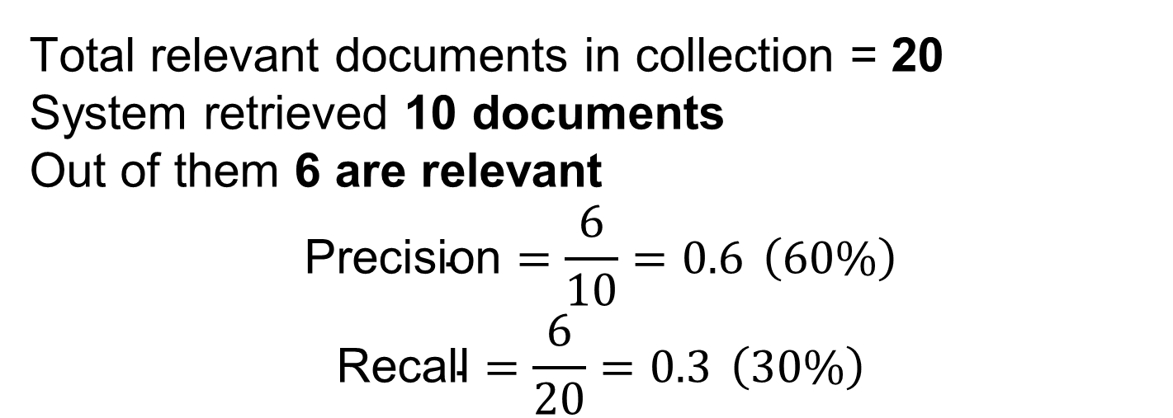
4 Example to Show Difference
Total relevant documents in collection = 20
System retrieved 10 documents
Out of them 6 are relevant
$$\text{Precision}=\frac{6}{10}=0.6 \left(60\%\right)$$
$$\text{Recall}=\frac{6}{20}=0.3 \left(30\%\right)$$

Slide 17
4 Mini Exercise: Calculating Precision & Recall Scenario:
An IR system returns 8 relevant documents and 10 non-relevant documents for a query. There are 20 relevant documents in the collection.
Questions for students:
What is the precision of the system?
What is the recall of the system?

Slide 18
5 F1 Score
F1 Score is used when we need a balance between Precision and Recall.
It is the harmonic mean of Precision and Recall (not a simple average).
Useful when both false positives and false negatives are important.

Slide 19
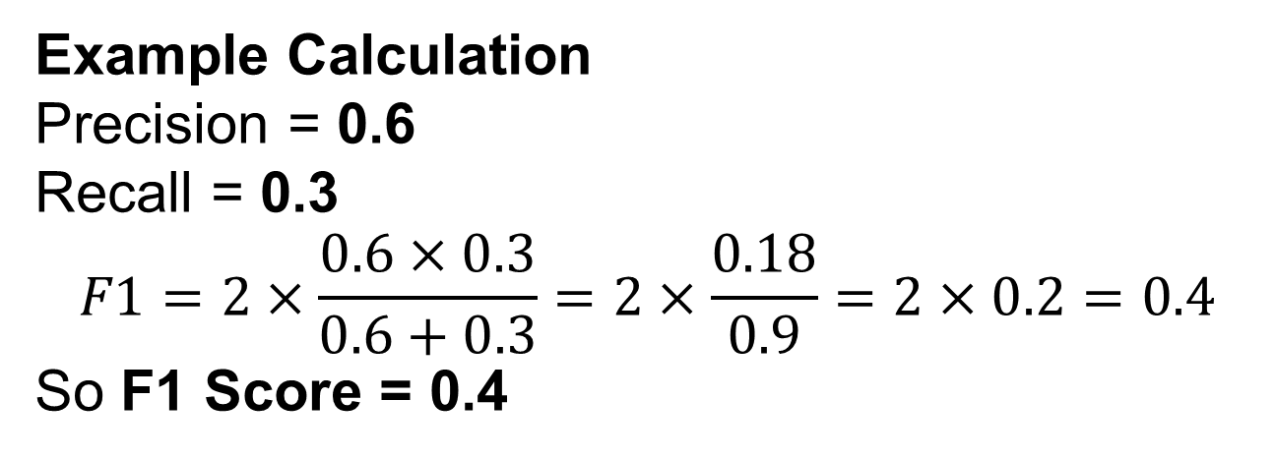

Formula $$F1=2×\frac{\text{Precision}×\text{Recall}}{\text{Precision}+\text{Recall}}$$
Example Calculation
Precision = 0.6 Recall = 0.3
$$F1=2×\frac{0.6×0.3}{0.6+0.3}=2×\frac{0.18}{0.9}=2×0.2=0.4$$
So F1 Score = 0.4

Slide 20
6 Mini Activity
1. Values:
Precision = 0.8
Recall = 0.4
Ask them to calculate F1 Score.
2. If Precision = 1 and Recall = 0, what will be the F1 Score? Why?

Slide 21
7 How Do We Know Which Documents Are Relevant?
To calculate Precision & Recall, we must know which documents are truly relevant for the query.
This information comes from Ground Truth (also called Gold Standard).

Slide 22
7 Ground Truth
A set of documents labeled as relevant by human experts.
Before testing an IR system, human judges or domain experts read documents and mark them:
Relevant (1)
Not Relevant (0)

Slide 23
8 Precision–Recall Trade-off
Precision and Recall usually cannot both be maximized simultaneously
Improving one often reduces the other
If we retrieve more documents, Recall increases but Precision may drop
If we retrieve fewer but very accurate results, Precision increases but Recall may drop

Slide 24
10 Example Scenario
Action | Effect on Precision | Effect on Recall
Retrieve more documents | ⬇ Precision | ⬆ Recall
Retrieve fewer documents (strict filtering) | ⬆ Precision | ⬇ Recall

Slide 25
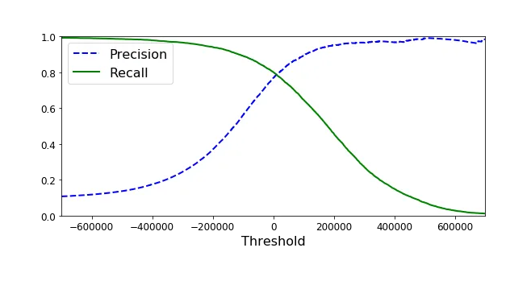

Slide 26
9 Real-Life Example
Searching for COVID-19 treatment research:
If the system retrieves everything → high recall but low precision (lots of useless papers)
If the system retrieves only top 3 top-ranked papers → high precision but low recall (may miss important studies)

Slide 27
9 Quick Activity
Give students two statements and ask them to vote:
A) Online shopping product search — what matters more? B) Police criminal database search for suspects — what matters more?
Expected:
A → Precision
B → Recall

Slide 28
11 Precision–Recall Curve
We fix spelling errors by checking which correct word looks the most similar to the misspelled one.

Slide 29
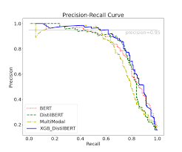

Slide 30
14 Graph Explanation
Position on Curve | Meaning
Top-right corner | Best possible (high precision & recall)
Top-left | Very accurate but finds few relevant
Bottom-right | Finds most relevant but accuracy low
Bottom-left | Bad performance

Slide 31
15 Average Precision (AP)
Average Precision measures the quality of ranked retrieval results
It combines precision at every relevant document position in the ranking
It rewards systems that retrieve relevant documents earlier in the result list

Slide 32
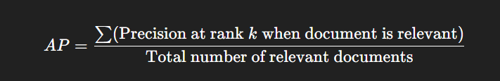
15 Formula

Slide 33
15 Example Table
Rank | Document | Relevant?
1 | D8 | No
2 | D2 | Yes
3 | D3 | No
4 | D4 | Yes
5 | D5 | Yes
6 | D9 | No
7 | D7 | Yes
8 | D1 | No
9 | D6 | No
10 | D10 | No

Slide 34
15 Step 1 — Precision at every relevant document
Step 1 — Precision at every relevant document
We compute precision only at ranks where a relevant document appears.

Slide 35
15 Average Precision
At Rank 2 → Document D2 is relevant
Precision = (# relevant up to rank 2) ÷ (rank) = 1 / 2 = 0.5

Slide 36
15 Average Precision
At Rank 4 → Document D4 is relevant
Relevant so far = 2 Precision = 2 / 4 = 0.5

Slide 37
15 Average Precision
At Rank 5 → Document D5 is relevant
Relevant so far = 3 Precision = 3 / 5 = 0.6

Slide 38
15 Average Precision
At Rank 7 → Document D7 is relevant
Relevant so far = 4 Precision = 4 / 7 ≈ 0.571

Slide 39
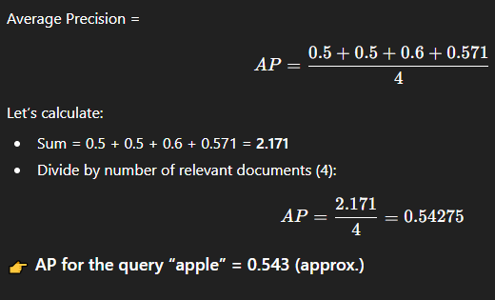
15 Step 2 — Compute Average Precision (AP)

Slide 40
15 Mean Average Precision (MAP)
MAP is the mean of the Average Precision (AP) values over multiple queries.
Used when evaluating the performance of an IR system across many search queries.
More reliable metric for real-world systems than AP alone.

Slide 41
15 Compute MAP across multiple queries - Example Table
Query | AP
apple | 0.543
banana | 0.700
fruit | 0.400

Slide 42
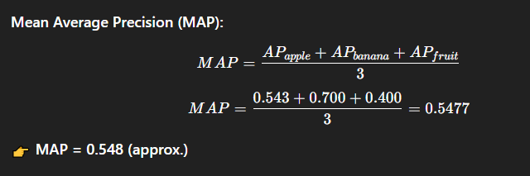
15 Mean Average Precision (MAP)

Slide 43
15 Precision at k (P@k) & R-Precision
Measures precision among the top k retrieved documents
Important because users usually look only at the first few results
Common values of k: P@5, P@10, P@20

Slide 44
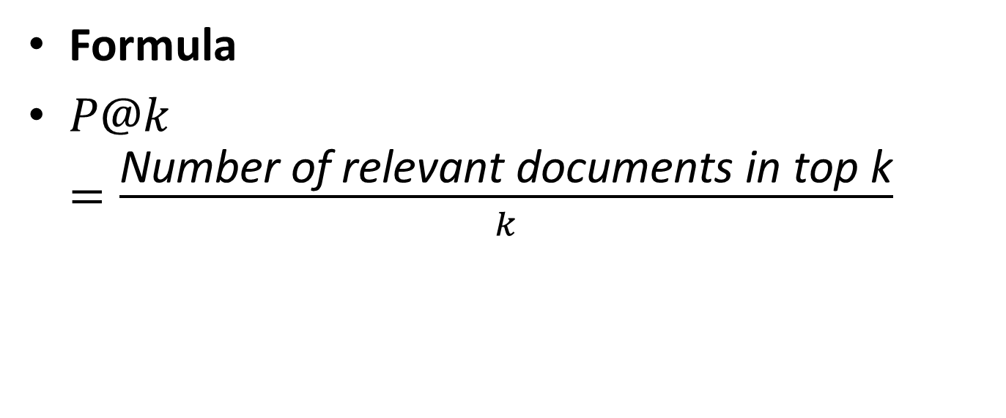
15 Precision at k (P@k) & R-Precision - Formula
Formula
$P@k=\frac{\text{Number} \text{of} \text{relevant} \text{documents} \text{in} \text{top} \text{k}}{k}$

Slide 45
15 Example - Precision at k (P@k) & R-Precision
For a query, the system retrieved first 10 documents, and 6 of them are relevant:
P@k = 6/10 = 0.6 (60%)

Slide 46
15 Why P@k is Useful?
Evaluates ranking quality at the top
Used in search engines, YouTube recommendations, e-commerce

Slide 47
15 R-Precision
Precision calculated at R, where R = number of total relevant documents in the collection for that query.
Example: If database has 20 relevant documents, then evaluate precision at rank 20

Slide 48
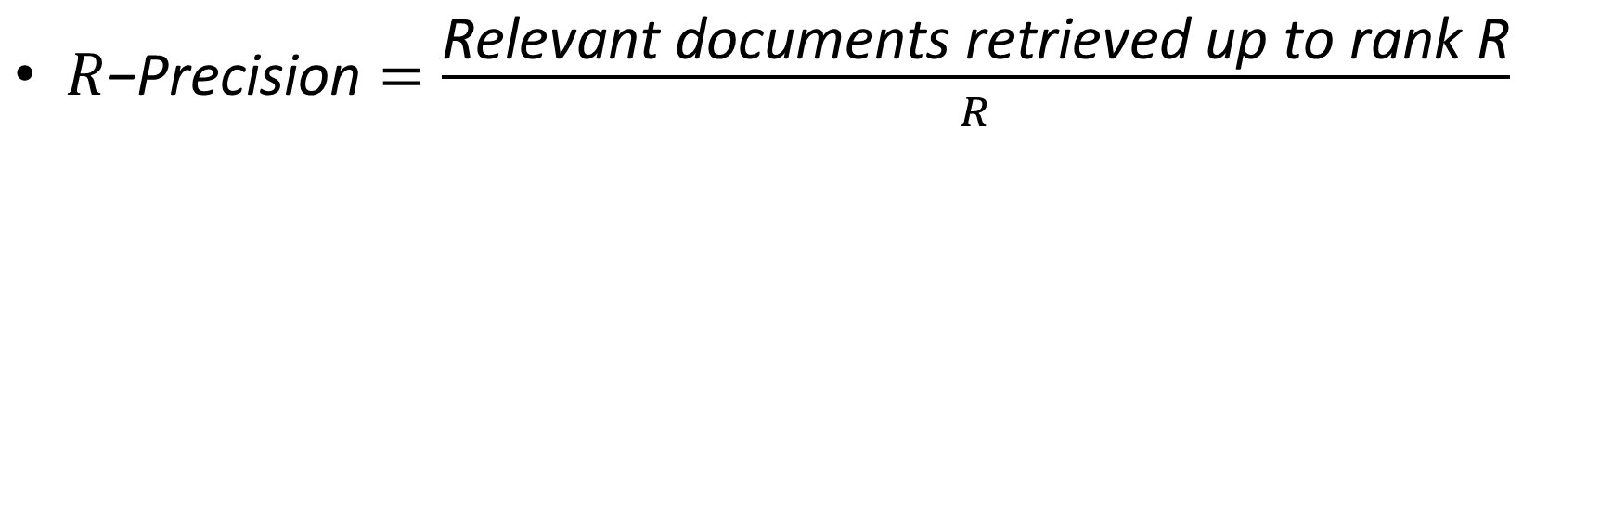
15 R-Precision Formula
$R\text{−}\text{Precision}=\frac{\text{Relevant} \text{documents} \text{retrieved} \text{up} \text{to} \text{rank} \text{R}}{R}$

Slide 49
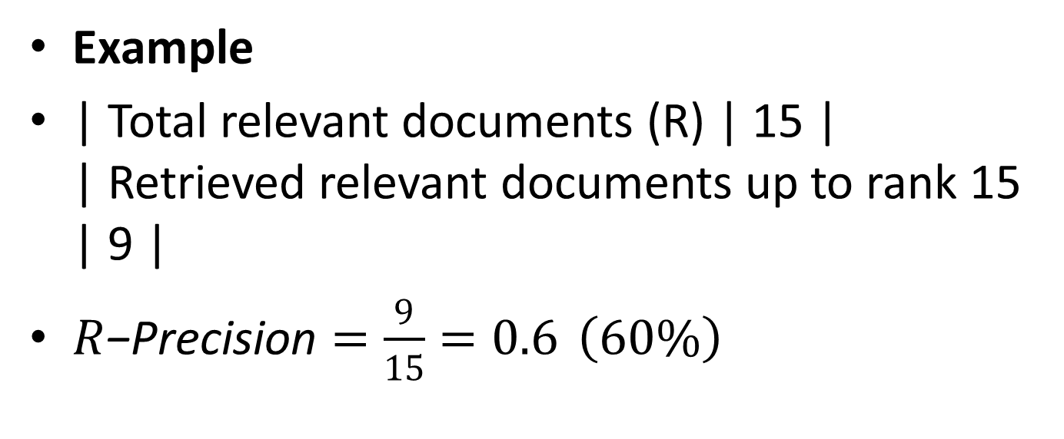
15 R-Precision
Example
| Total relevant documents (R) | 15 | | Retrieved relevant documents up to rank 15 | 9 |
$R\text{−}\text{Precision}=\frac{9}{15}=0.6 \left(60\%\right)$

Slide 50
15 Key Difference
Metric | Focus
P@k | Precision in top k results
R-Precision | Precision at total number of relevant docs

Slide 51
15 Test Collections
A test collection is a dataset used to evaluate and compare Information Retrieval systems.
It provides a standardized environment for testing.
Contains three main components:
Documents – the full database to search
Queries – user requests or search inputs
Relevance Judgments – specify which documents are relevant to each query

Slide 52
15 Examples of Popular Test Collections
Collection | Description
Cranfield | Classic IR test collection
TREC | Large evaluation conference dataset
CLEF | Cross-language evaluation
NTCIR | Asian language IR
MS MARCO | Web search evaluation

Slide 53
15 What are Relevance Judgments?
They are the “right answers” in an information retrieval system.
Determine whether a document is useful for a given query or information need.
Binary decision:
Relevant → document helps answer the information need
Not relevant → document doesn’t help
Even if a small part of the document is relevant, the document is considered relevant.

Slide 54
15 Test collection consists of:
Document collection
Queries (information needs)
Relevance judgments (Qrels)
Must ensure Qrels match the document collection when testing retrieval results.

Slide 55
15 How Relevance Judgments Are Made – Pooling Technique
1. Pooling Technique
Used to decide which documents to judge for relevance in large collections.
Steps:
Run multiple IR systems on the same query.
Take the top results from each system and combine them into a “pool.”
Human judges examine only these pooled documents.
This ensures most of the relevant documents are likely included, without judging the entire collection.

Slide 56
15 How Relevance Judgments Are Made – Pooling Technique
2. Completeness
The relevance judgments are considered “complete” for that particular set of documents.
“Complete” means enough results have been judged so that most relevant documents have been found.

Slide 57
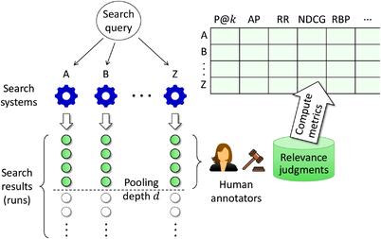

Slide 58
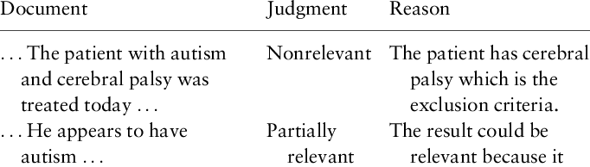

Slide 59
15 Experimental Design in IR Evaluation
To compare IR systems fairly and understand if observed differences are meaningful.
1. Separate Development and Test Sets
2. Random Sampling of Queries
3. Repeated Experiments

Slide 60
15 Significance Testing
To determine if differences in performance metrics (precision, recall, MAP) between systems are statistically meaningful.
Avoid drawing conclusions from random variations in results.

Slide 61
15 Common Tests Significance Testing
t-test: Compare mean performance of two systems.
Wilcoxon signed-rank test: Non-parametric alternative for paired comparisons.
ANOVA: Compare multiple systems simultaneously.

Slide 62

Thank you…
“If spelling errors cause mismatches and confusion in search, what can an IR system do to still understand the user’s intended word?”

